Slide 1
ON CALL INTERNATIONAL GLOBAL ASSISTANCE & INSURANCE PROGRAM Administrators Training

Slide 2
TRAVEL RISK MANAGEMENT and DUTY OF CARE
PROTECT YOUR PEOPLE
PROTECT YOUR INVESTMENT
Institutions that fail to protect their people risk significant legal, financial and reputational damage.
PROTECT YOUR
INSTITUTION
Developing a travel risk management plan helps fulfill the your duty of care responsibility.

Slide 3
Components of a HOLISTIC Travel Risk Management Plan
ASSESSMENT
OF YOUR SCHOOL’S UNIQUE RISK PROFILE?
REPETITION KEEPING YOUR PLAN UP TO DATE
PLANNING HOW YOU
WILL RESPOND TO THAT RISK
ENFORCEMENT
OF POLICIES
PUT IN PLACE TO PROTECT TRAVELERS
TESTING
TO ENSURE NO GAPS IN YOUR RESPONSE PLAN
EDUCATION
ABOUT DESTINATION AND RESOURCES AVAILABLE TO ASSIST

Slide 4
YOUR PLAN
On Call provides Students, Faculty and Staff with access to immediate support when traveling on an academic program or business trip.
This is a blanket plan which means travelers do not need to enroll. Assistance is available worldwide and benefits are effective upon departure from the US or a travelers home country. Coverage does not apply in the US.

Slide 5
PROACTIVE
Preparation and Education
REACTIVE
Assistance and Insurance

Slide 6
PROACTIVE ASSISTANCE SERVICES
Administrator Training Services
Traveler Education Services
PROACTIVE: EDUCATION AND PREPARATION
Online Traveler Resource Center
Travel Risk Management Security Services

Slide 7
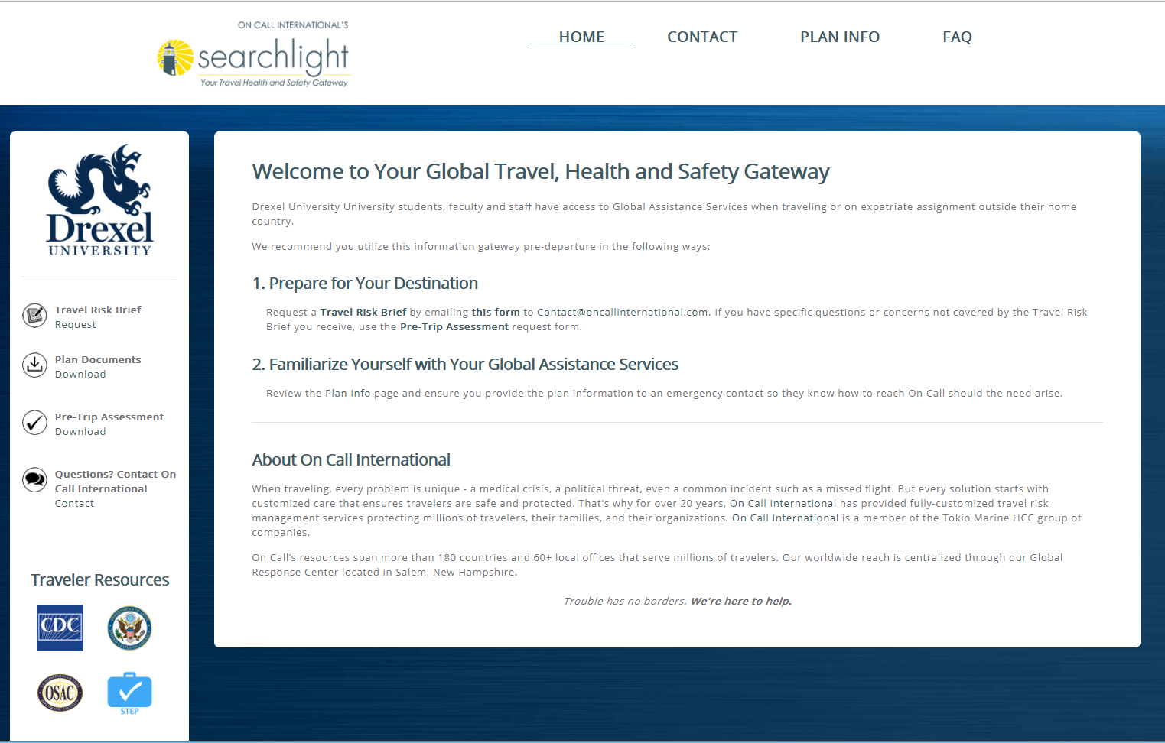
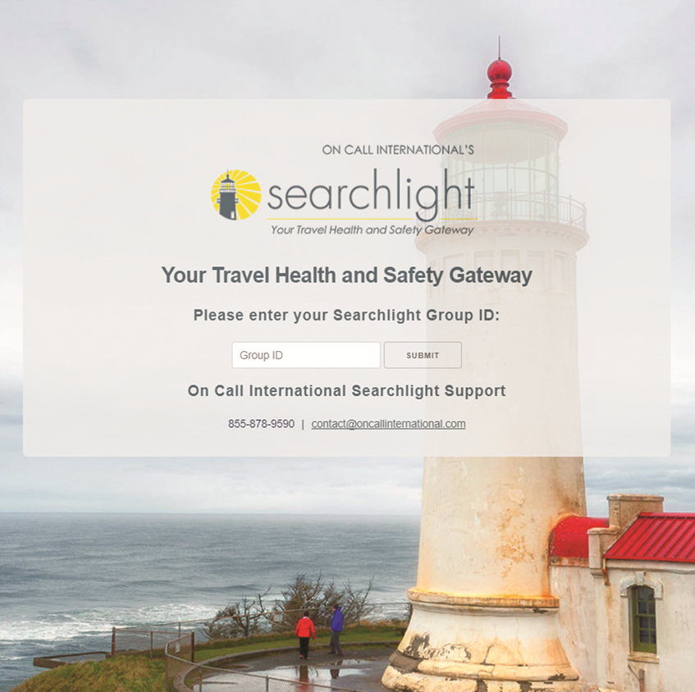
https://mysearchlightportal.com
Searchlight Group ID: 100022COPD14
Travel Risk Brief
Standing health and safety destination info
Pre Trip Evaluation
Identifies risk unique to your risk profile

Slide 8
REACTIVE ASSISTANCE SERVICES
Security Evacuation & Assistance Services
REACTIVE: ASSISTANCE &
INSURANCE
Emergency and non-Emergency Travel Services
Medical Evacuation &
Assistance Services

Slide 9
24/7 GLOBAL
RESPONSE CENTER
Assistance Coordinators
Transportation Managers
Rescue Nurses
Nurse Helpline
In-House and Staff Physicians
Nurse Case Managers
Global Security Specialists
Providing Assistance
for Over Two Decades
Global Presence, Local Solution

Slide 10
MEDICAL ASSISTANCE
WE ASSIST WHEN...
Any level of medical care is needed
Level or urgency of care needed is unclear
A traveler needs assistance finding a hospital, doctor, pharmacy, dentist or eye doctor
There is a hospitalization
A prescription is lost or stolen

Slide 11
MEDICAL CASE MANAGEMENT
On Call will request consent to release medical information from the patient
Travelers should be prepared to self-pay and submit a claim to their medical insurer. On Call will facilitate payment of medical expenses only if authorized by an Authorized Operations Contact.
When deemed medically necessary, On Call will arrange for evacuation to the closest appropriate facility or repatriation to home country
Authorized Operations Contact’s at the school will be notified and updated throughout the case

Slide 12
TRAVEL ASSISTANCE
FLIGHT AND HOTEL
REBOOKING ASSISTANCE
LOST AND MISSING
LUGGAGE ASSISTANCE
EMBASSY AND CONSULATE
REFERRALS
TRANSLATION
AND INTERPRETERS
LEGAL CONSULTATION
AND REFERRALS
EMERGENCY TRAVEL FUNDS ASSISTANCE

Slide 13
EMERGENCY TRAVEL ARRANGEMENTS
Family / Friend travel to bedside when hospitalized for 24 hours or more
Return home due to family member death or illness
Bereavement Reunion, in the event of death
Return home of dependent children
Chaperone Replacement
ON CALL MUST PAY AND MAKE ARRANGMENTS
THESE ARE NOT REIMBURSEABLE BENEFITS

Slide 14
A travelers safety has been compromised
Caller will be connected with a Global Security Specialist
The GSS team will evaluate the situation and provide safety advice
Evacuation and return home will be arranged if deemed necessary
SECURITY ASSISTANCE
CALL US IF...
NATURAL DISASTER EVACUATION
POLITICAL EVACUATION

Slide 15
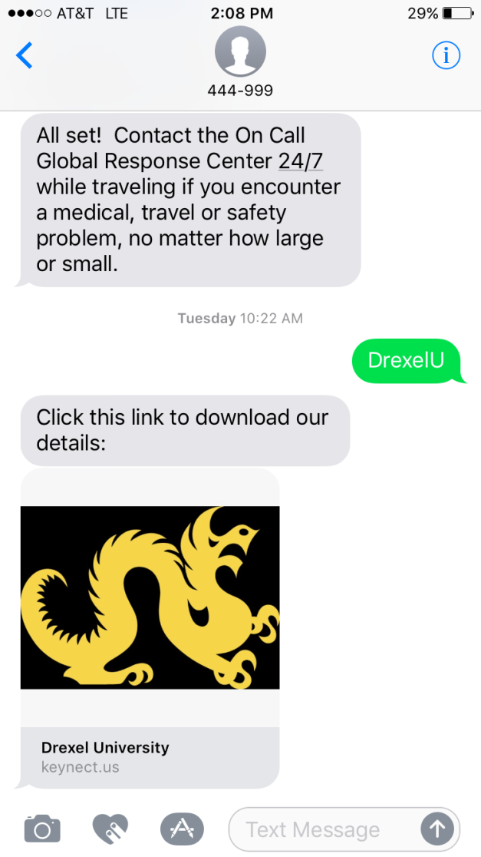
ADD THE 24/7 ASSISTANCE LINE TO YOUR PHONE:
Send a text:
DrexelU to 444-999
(not case sensitive)
Click the link
(it is NOT an app!)
Enter your name and tap Submit
Tap “Open in Contacts”
SAVE the contact
© 2017 On Call International All rights reserved.

